Slide 1
The contribution of Jupiter-family comets to the fireball population
Patrick Shober, G. Tancredi, J. Vaubaillon, H. Devillepoix, S. Deam, S. Anghel, E. Sansom, F. Colas, S. Martino

Slide 2
https://www.fripon.org/

Slide 4
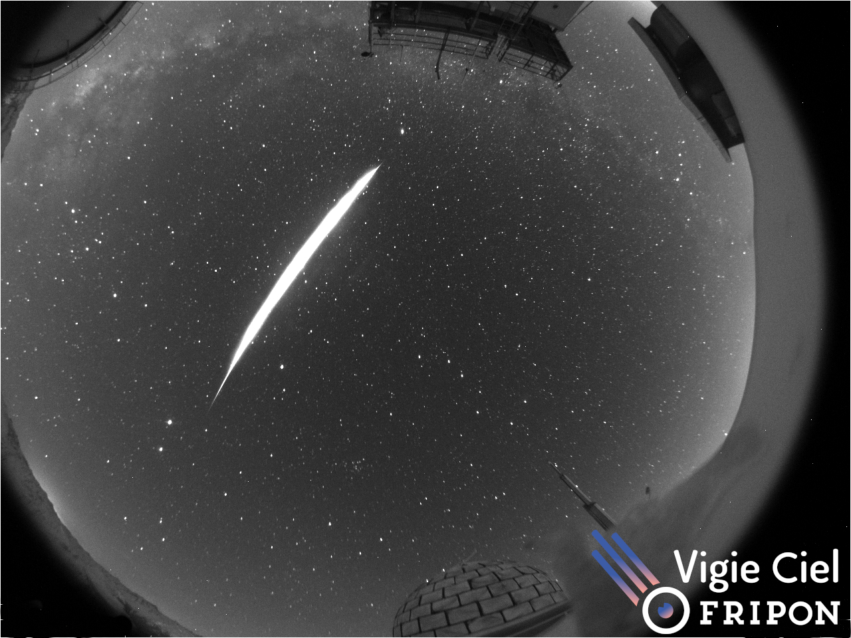

Slide 7
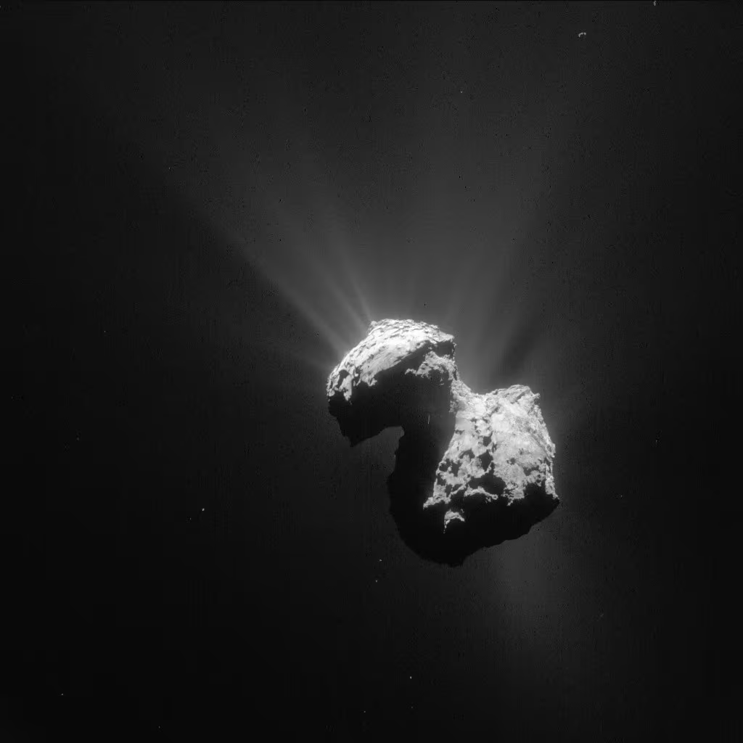
Image Credit: ESA Rosetta Mission

Slide 8
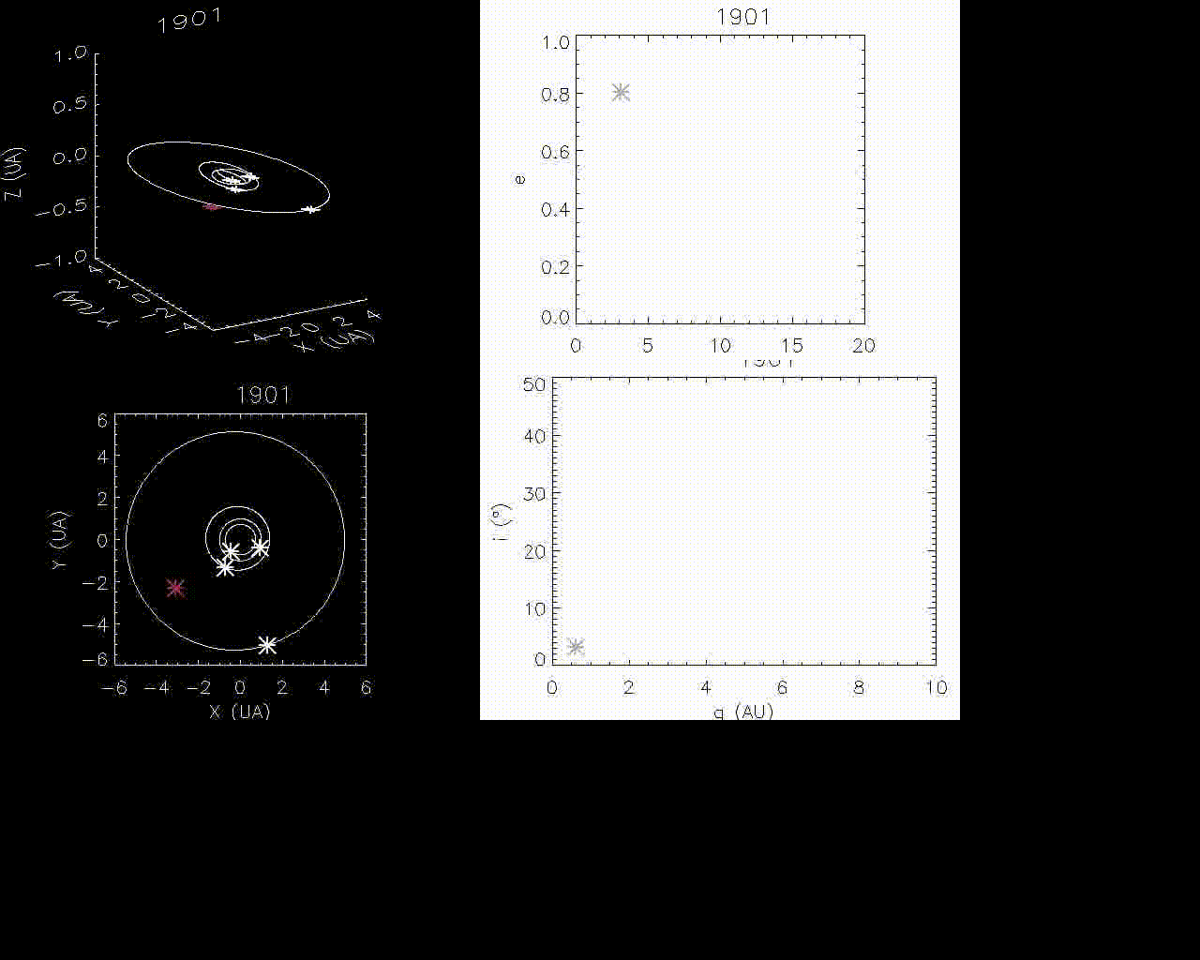
45P/Honda–Mrkos–Pajdušáková
Vaubaillon & Christou (2006)

Slide 9
Previous work
Several JFCs in near-earth space on extremely stable, ‘asteroid like’ orbits.
Lyapunov lifetimes of JFCs tend to concentrate towards 50-150 yrs
(Fernandez et al. 2014, 2015)
(Tancredi 1995)
Dynamical lifetime
of JFCs is ~1.5 × 10⁵ yrs, however, they only typically spend ∼ 10³ yrs as NEOs
Nearly all DFN sporadic JFC-like (2 < T_{J} < 3) fireballs are very stable on 10⁴ yr timescales
(Shober et al. 2021)
(Fernandez et al. 2002)

Slide 10
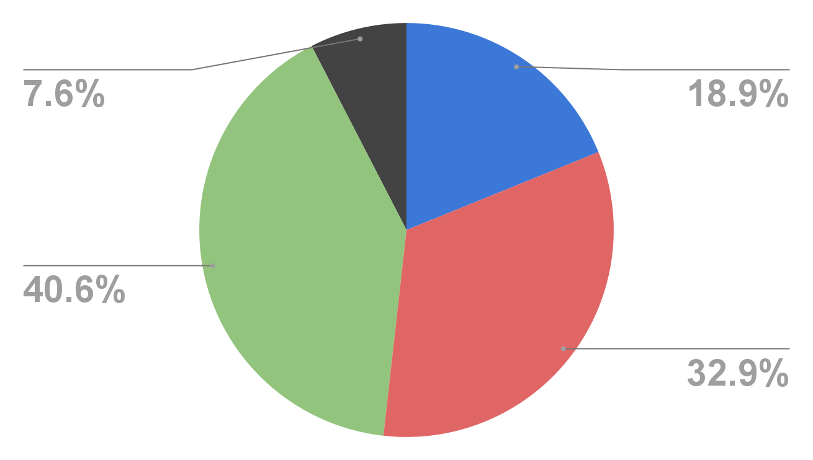
646 fireballs
661 JFCs

Slide 11
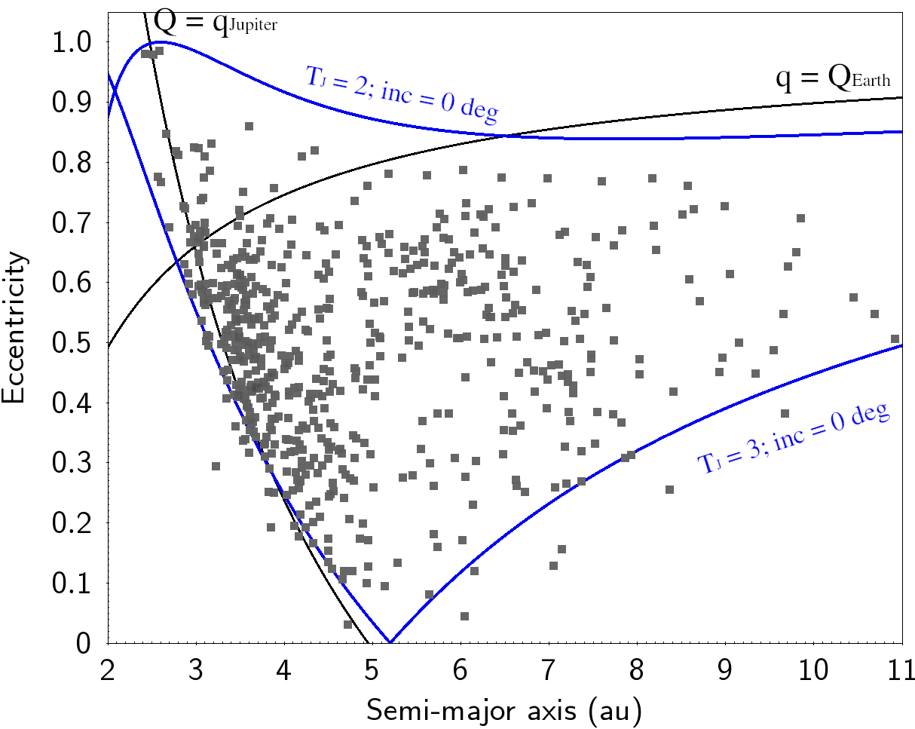
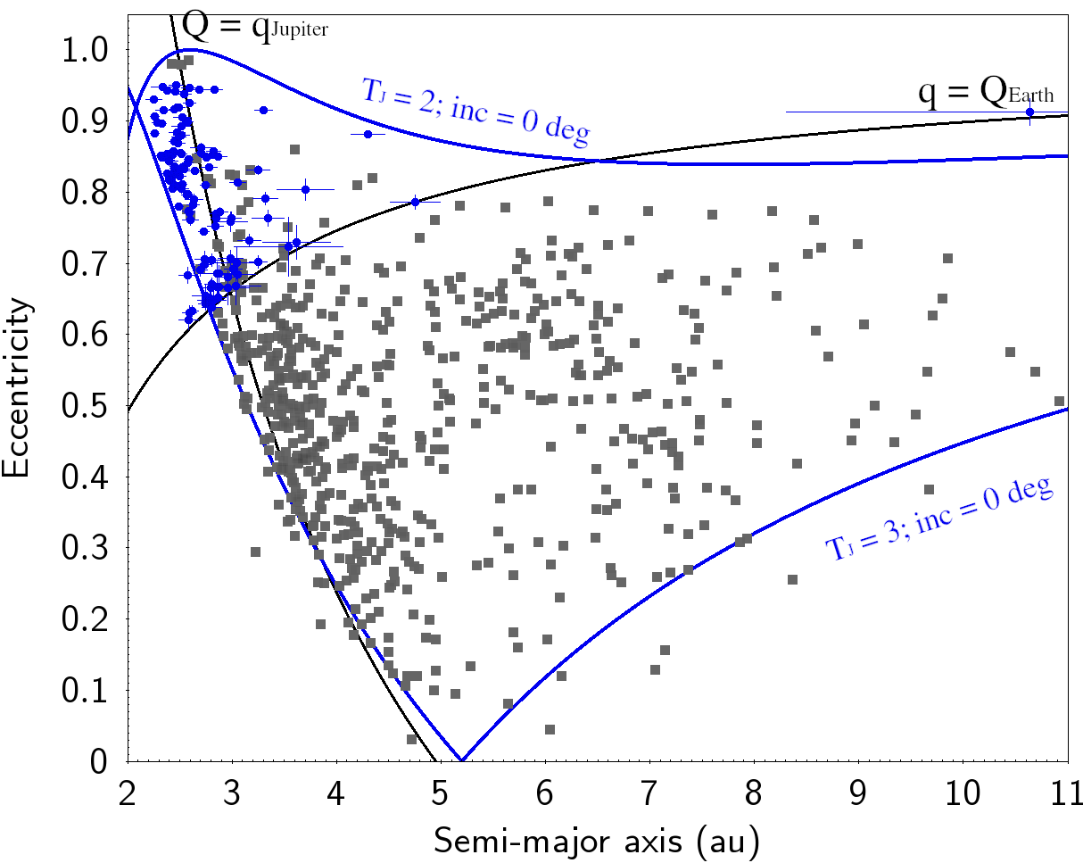
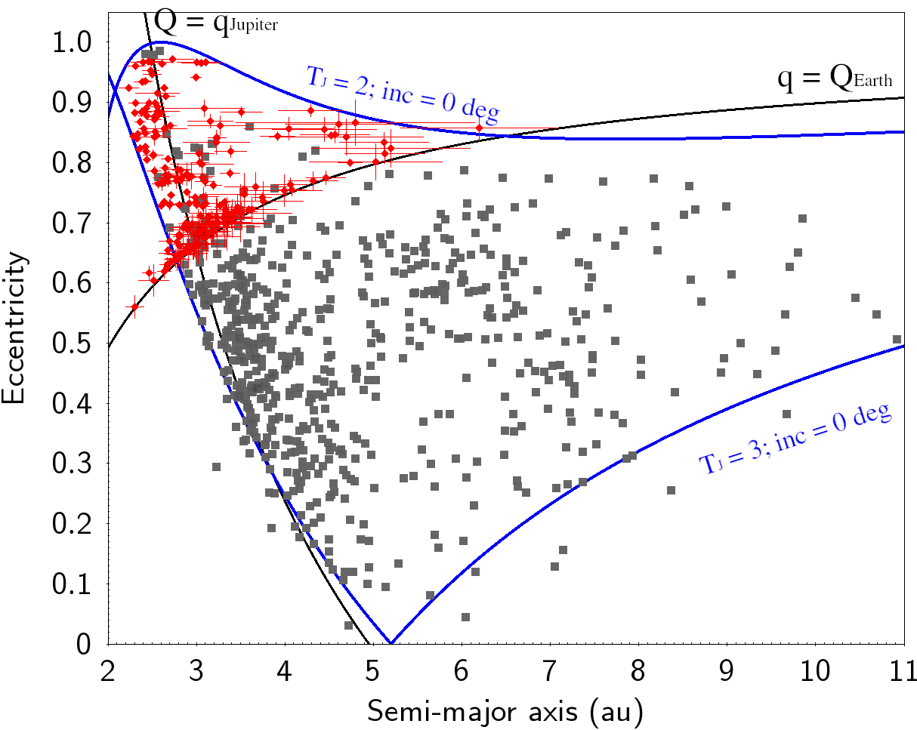
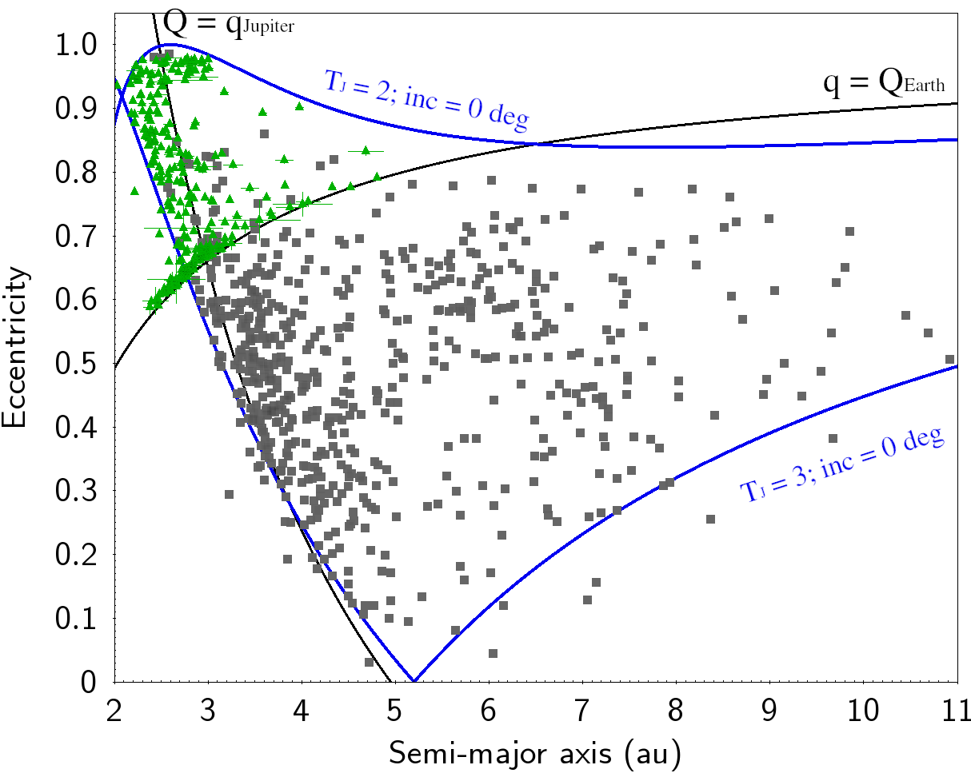
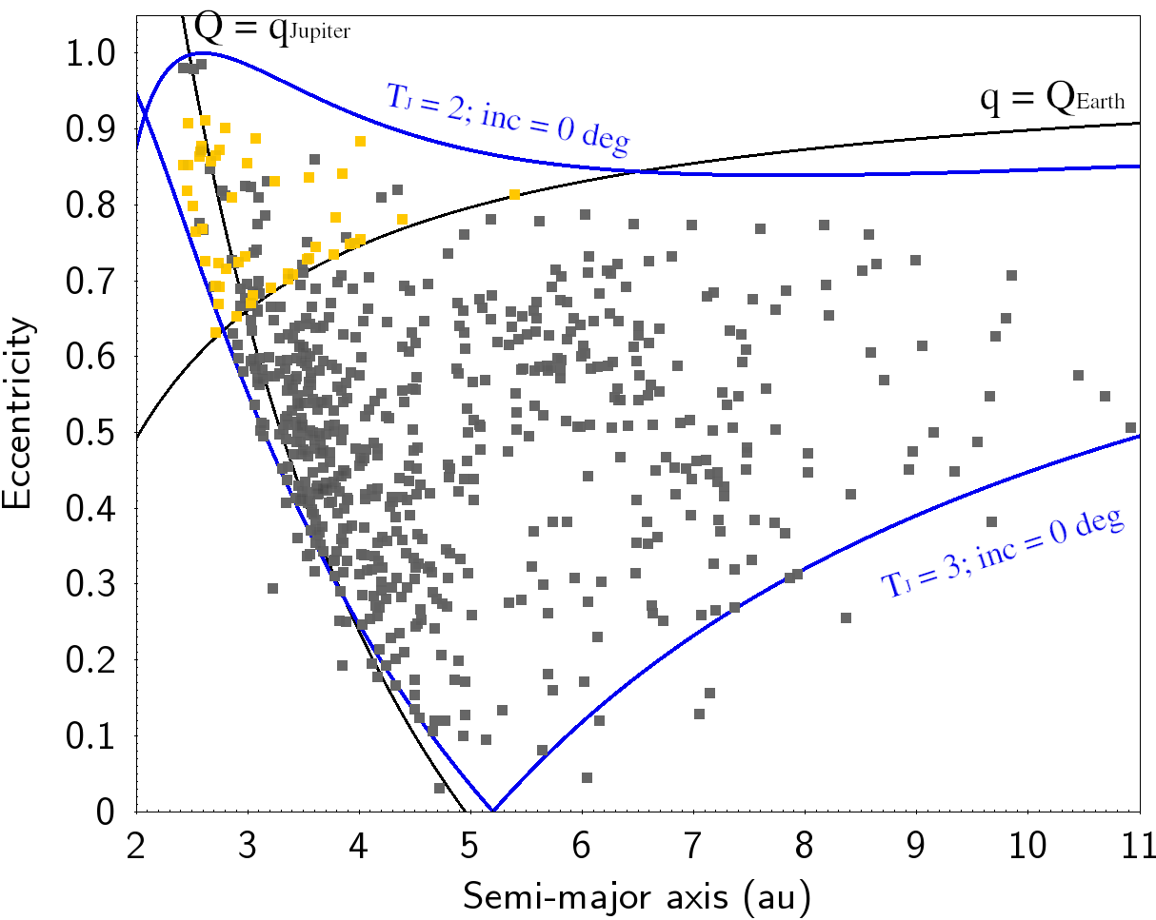
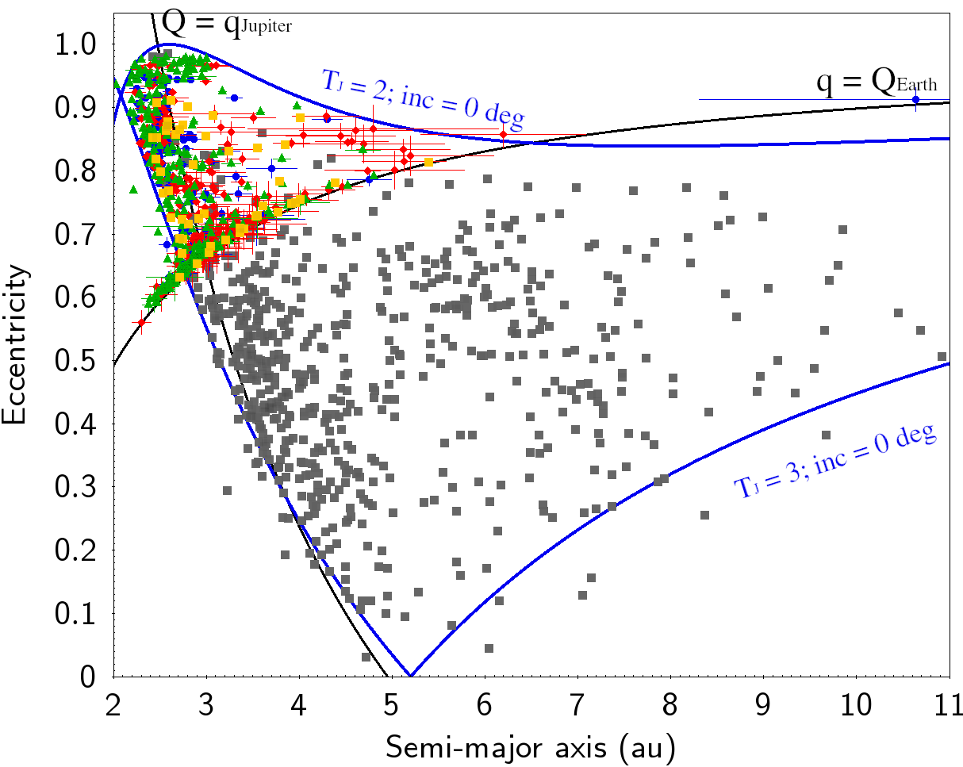
MORP
FRIPON
DFN
EFN

Slide 12
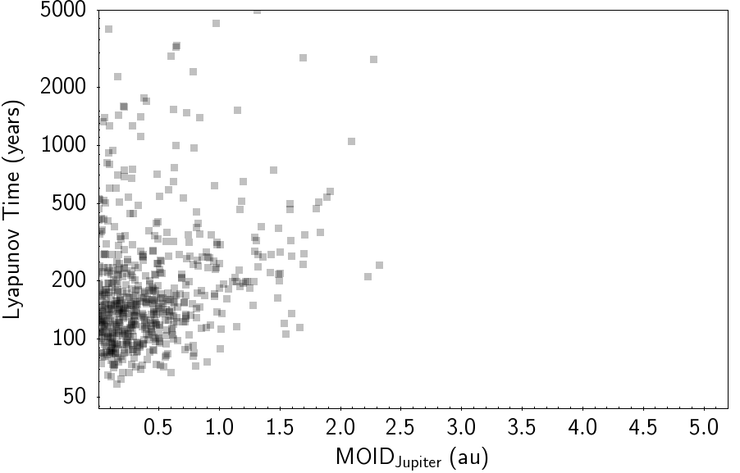
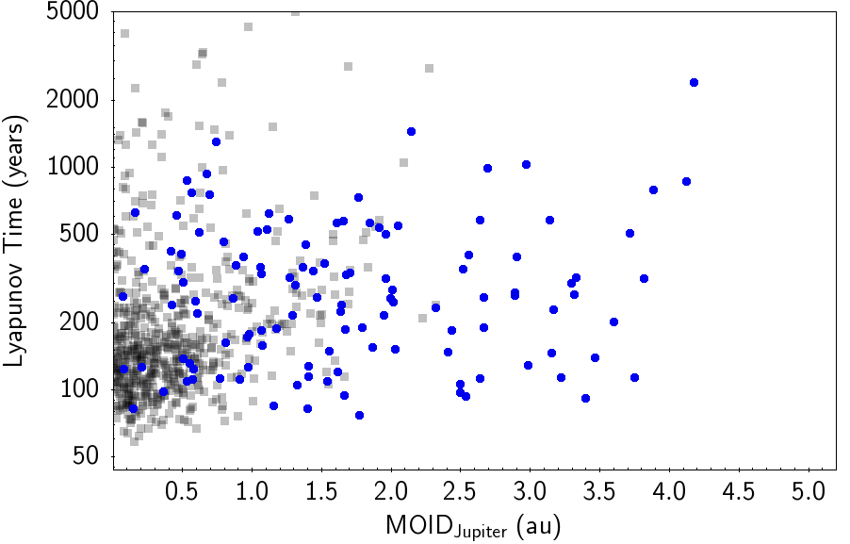
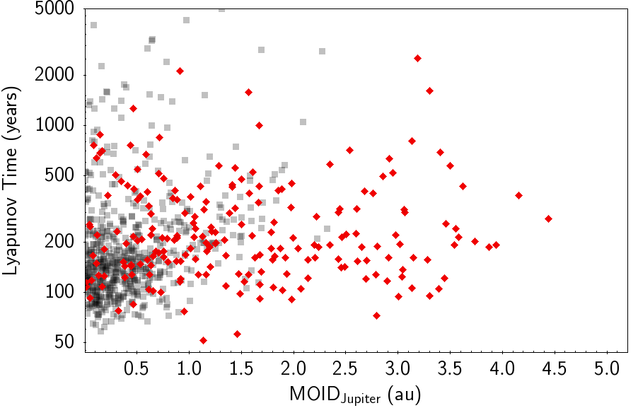
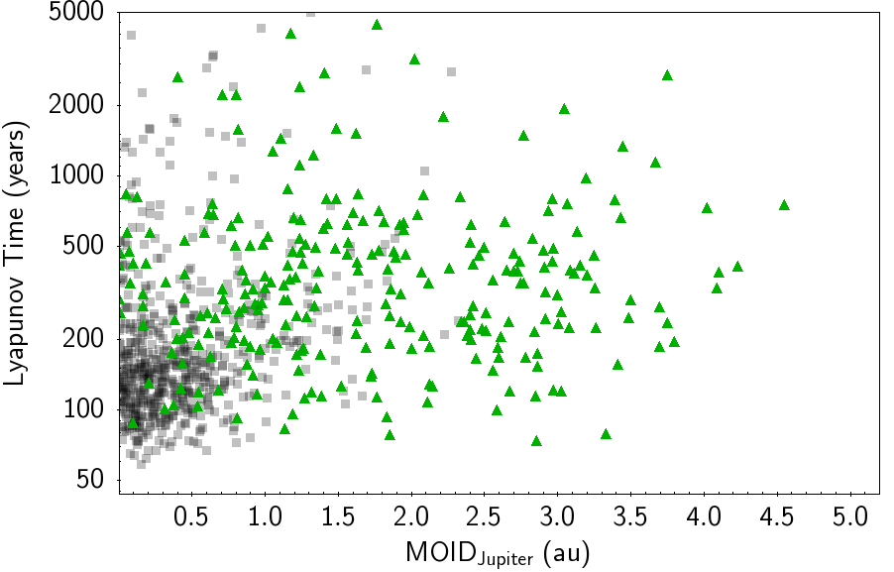
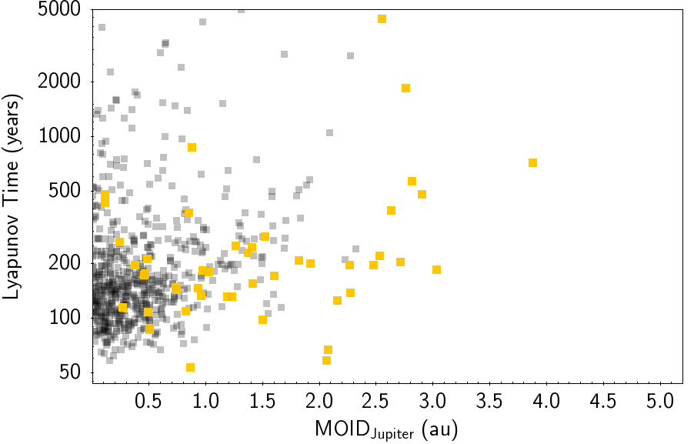
FRIPON
MORP
DFN
EFN

Slide 13
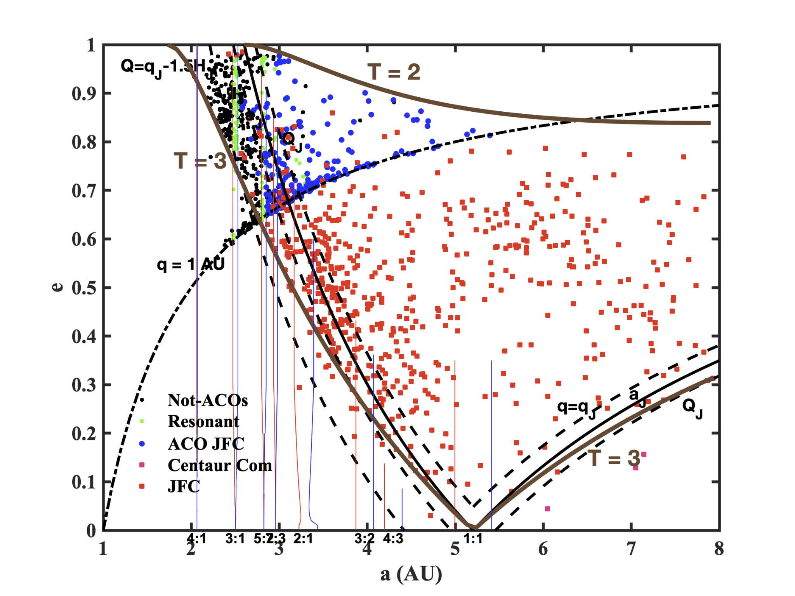
Using the Tancredi (2014) Criterion
Only 35% on cometary orbits

Slide 14
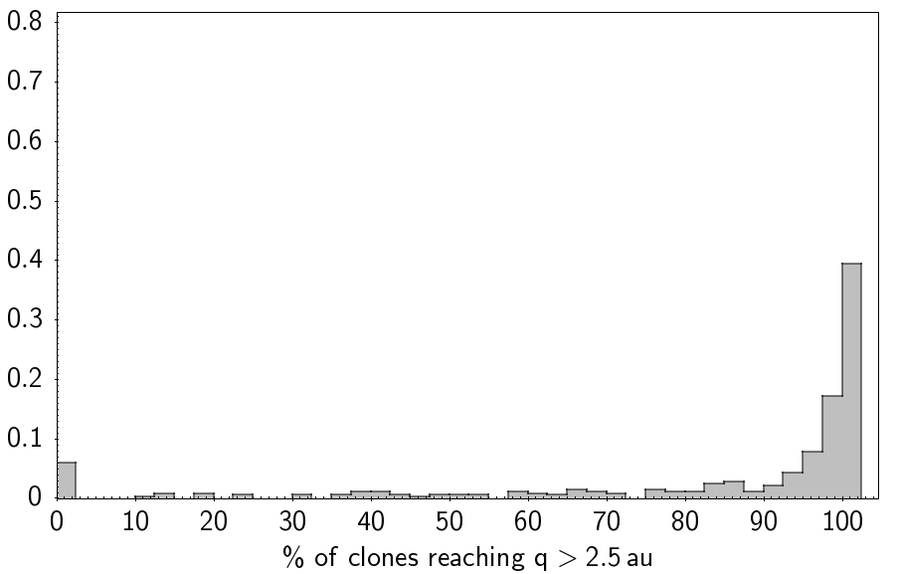
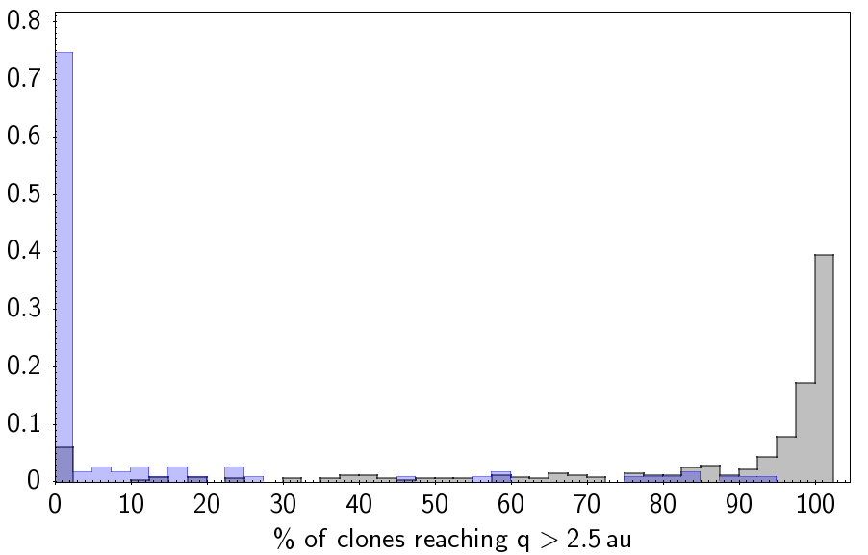
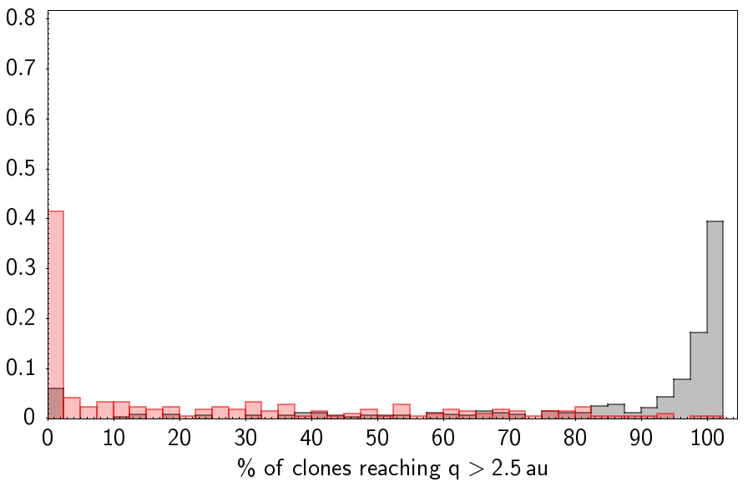
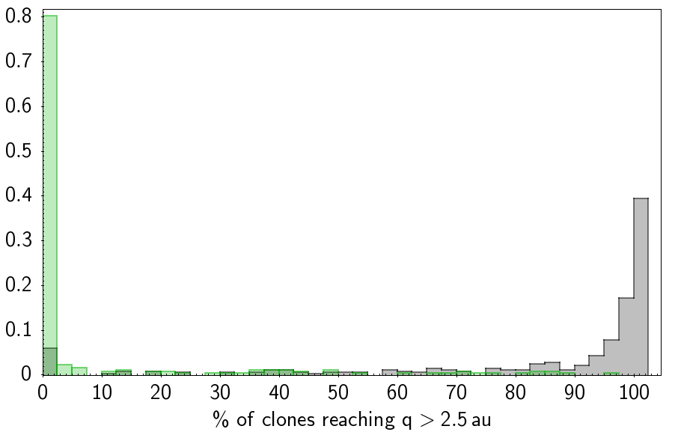
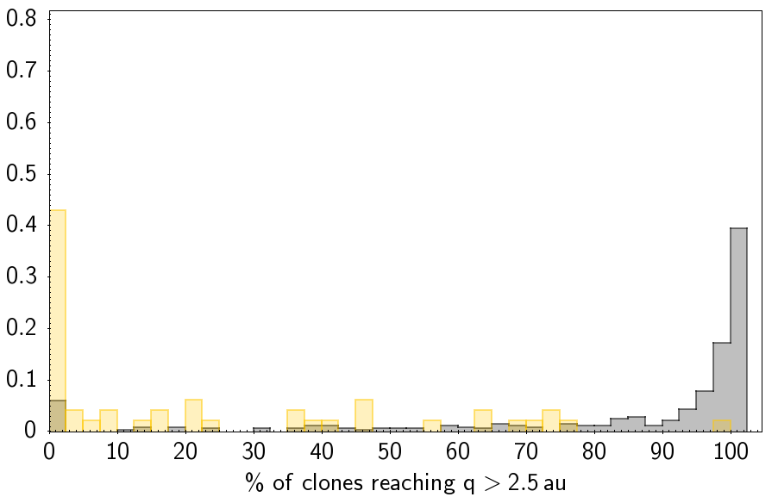
FRIPON
MORP
DFN
EFN
661 JFCs
They leave ‘active region’ very quickly
% of clones reaching q > 2.5 au

Slide 15
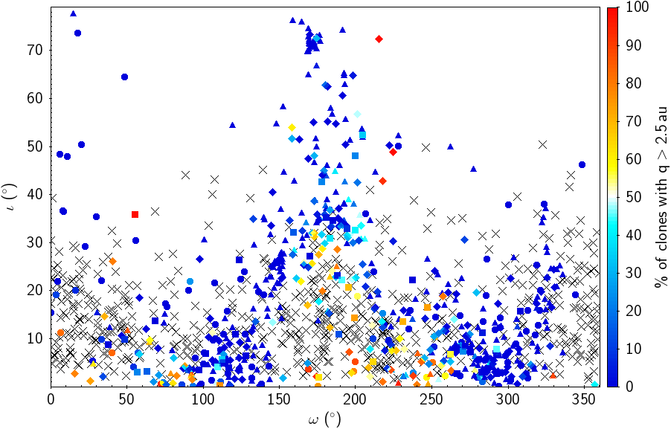

Slide 16
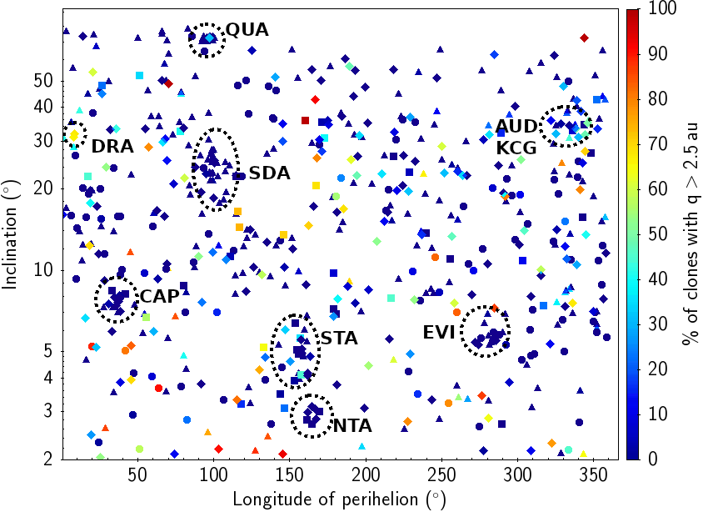

Slide 17
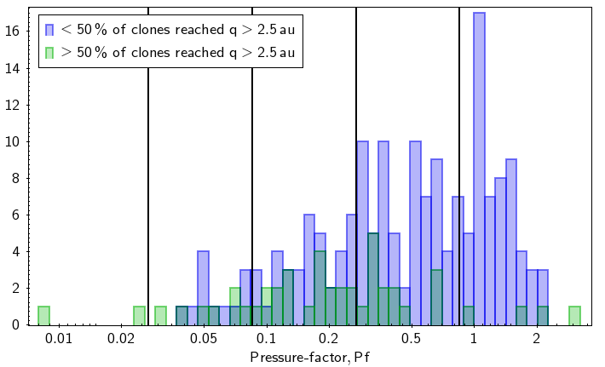

Slide 18
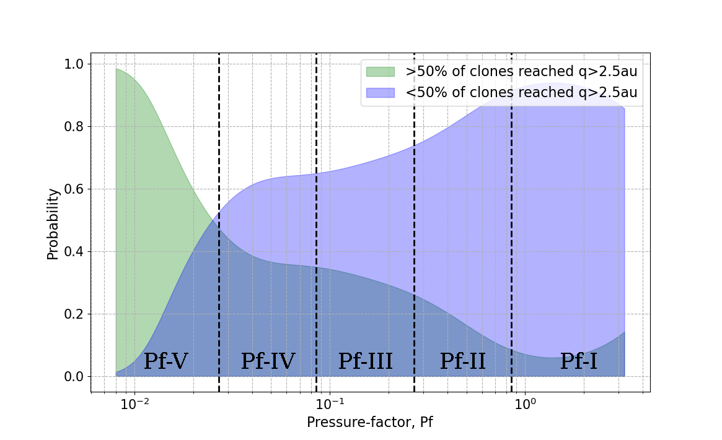
Comet-like
dynamics
Asteroid-like dynamics
Weaker :(
Stronger 💪

Slide 19
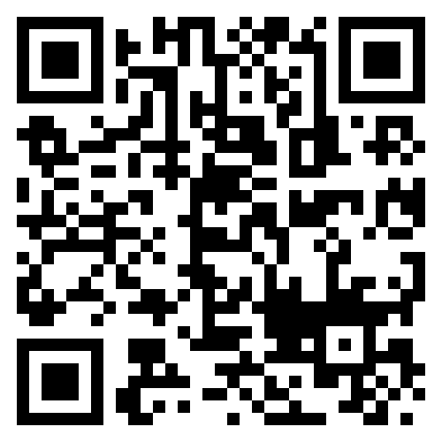
COMET RESULTS
The Lyapunov lifetimes of the 661 JFCs tend to concentrate towards lower values (~120 yrs)
22% (16 out of 72) JFCs in near-Earth orbits move on extremely stable orbits

Slide 20
FIREBALL RESULTS
No Lyapunov lifetime concentration
1-5% of fireball datasets are dynamically consistent with JFCs
Only 35 % fit ‘cometary’ criterion set by Tancredi (2014)
All in strong Kozai-resonance, induced circulation of the argument of perihelion
Only 8-21% have comet-like dynamics over 10 kyrs
Weak meteoroid ≠ cometary … necessarily

Slide 21
To check out the paper in A&A :) →

Slide 22
